Slide 1


Generative AI
Retrieval Augmented Generation (RAG)

Slide 2
outline
RAG

Slide 3
Retrieval Augmented Generation (RAG)

Slide 4
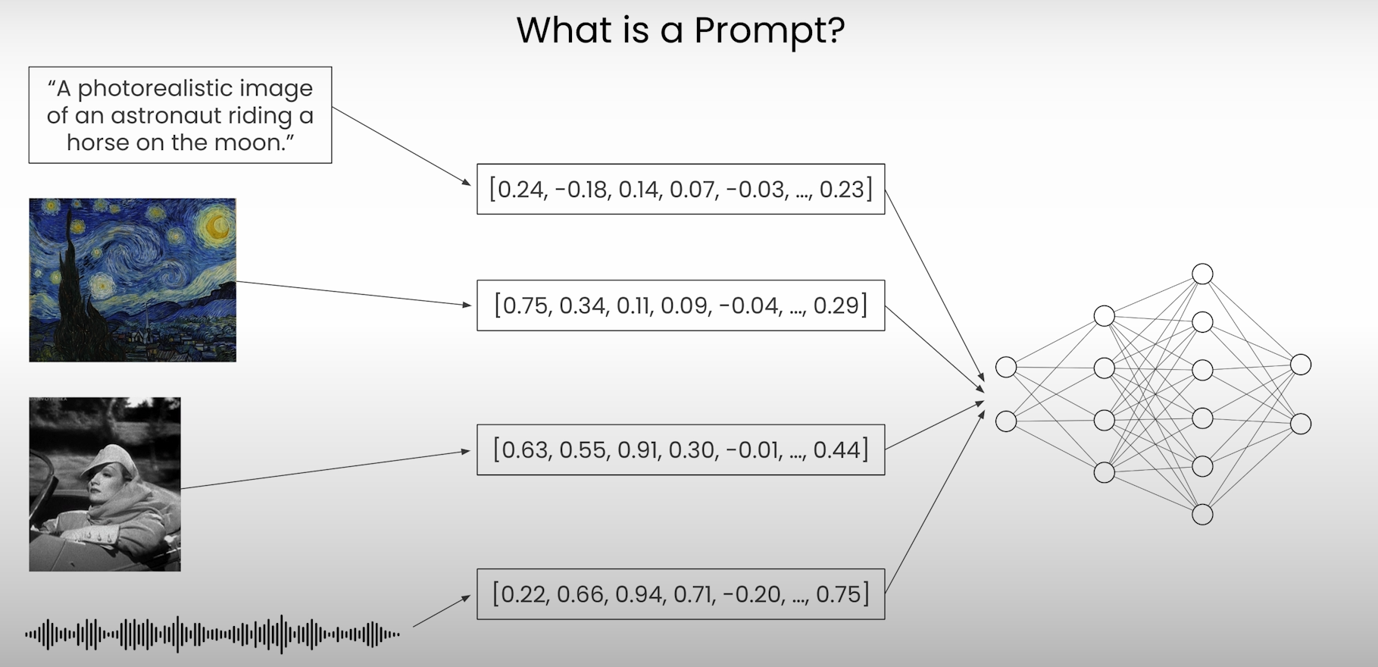
What is a prompt? - recap

Slide 5
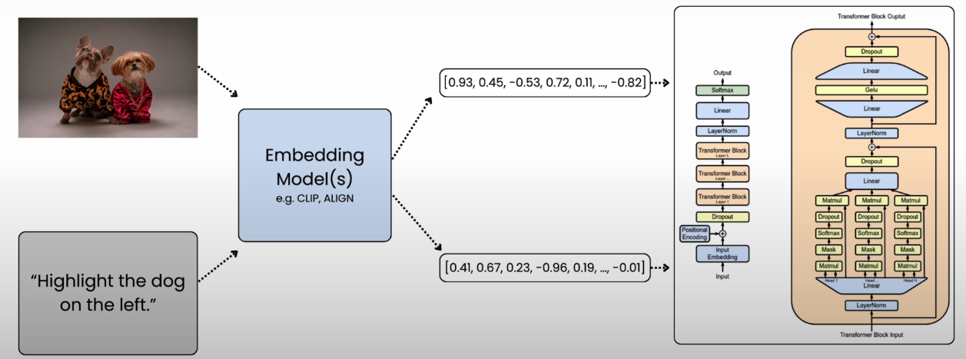
Embeddings - recap

Slide 6
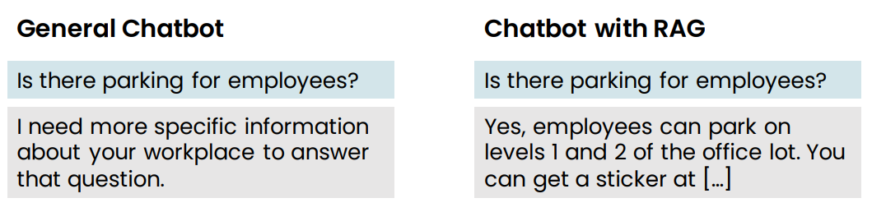
Retrieval Augmented Generation (RAG) example
Retrieval augmented generation (RAG)
• Give LLM access to external data sources

Slide 7
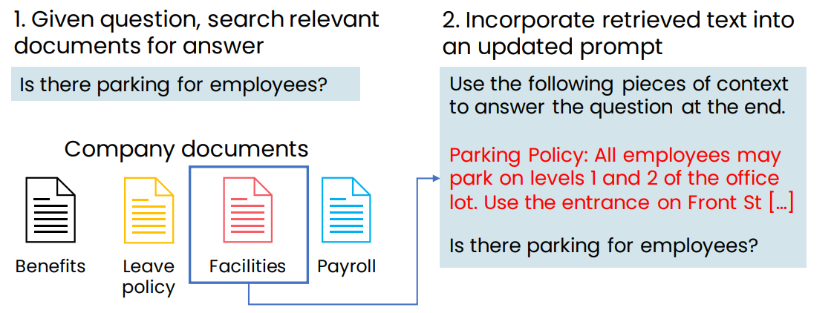
Retrieval Augmented Generation (RAG) example

Slide 8
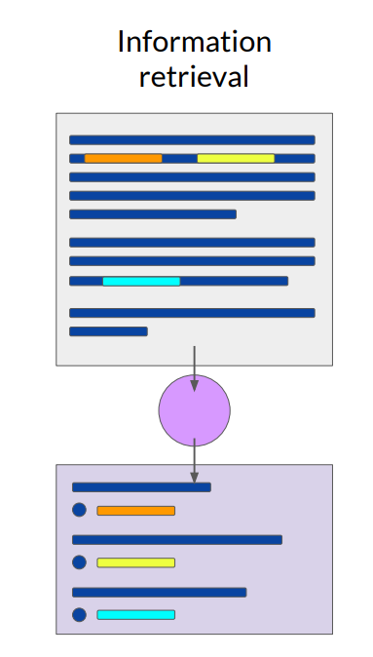
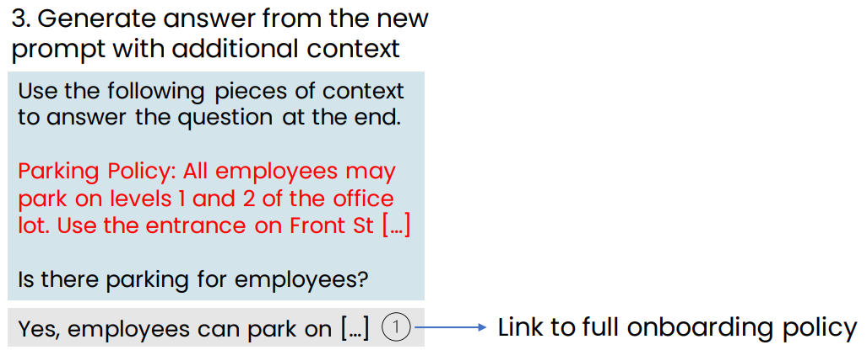
Retrieval Augmented Generation (RAG) example

Slide 9
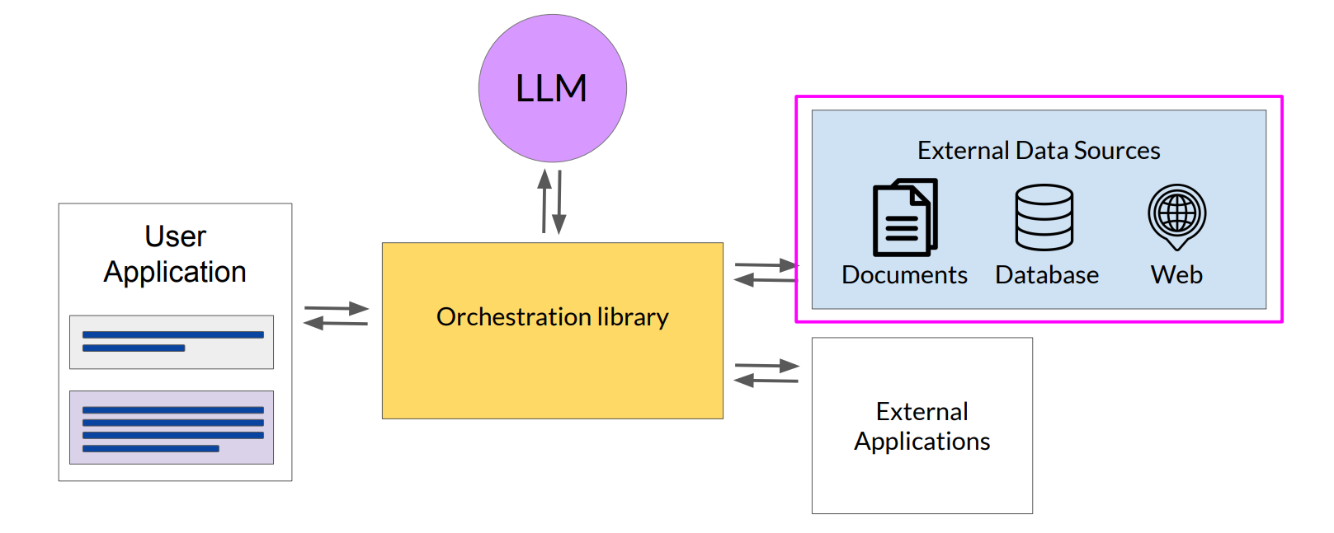
LLM-powered applications Retrieval Augmented Generation RAG

Slide 10
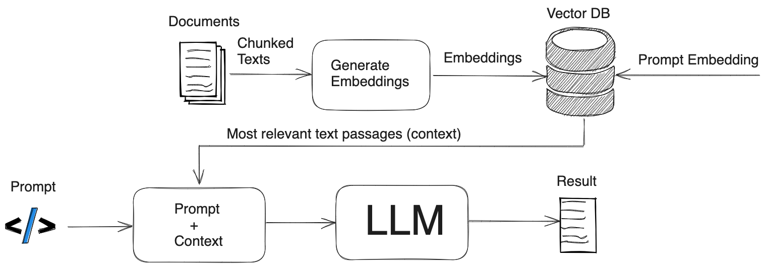
RAG

Slide 11
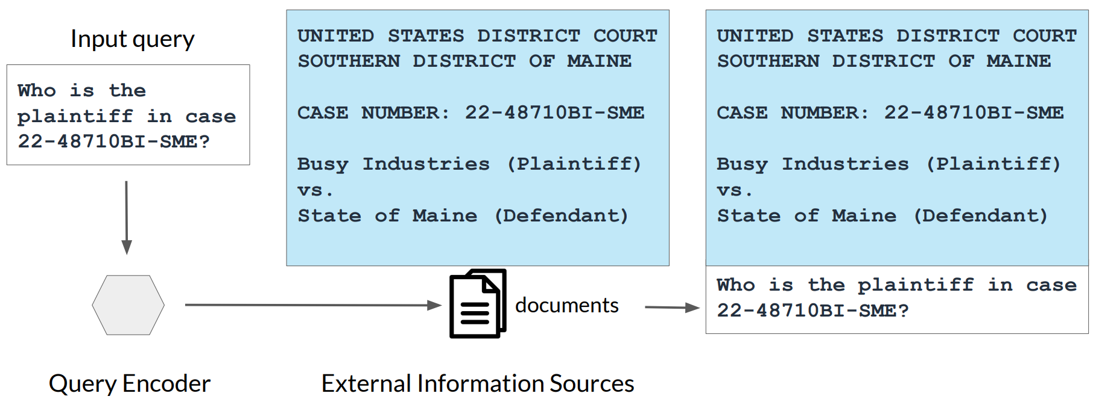
Example: Searching legal documents

Slide 12
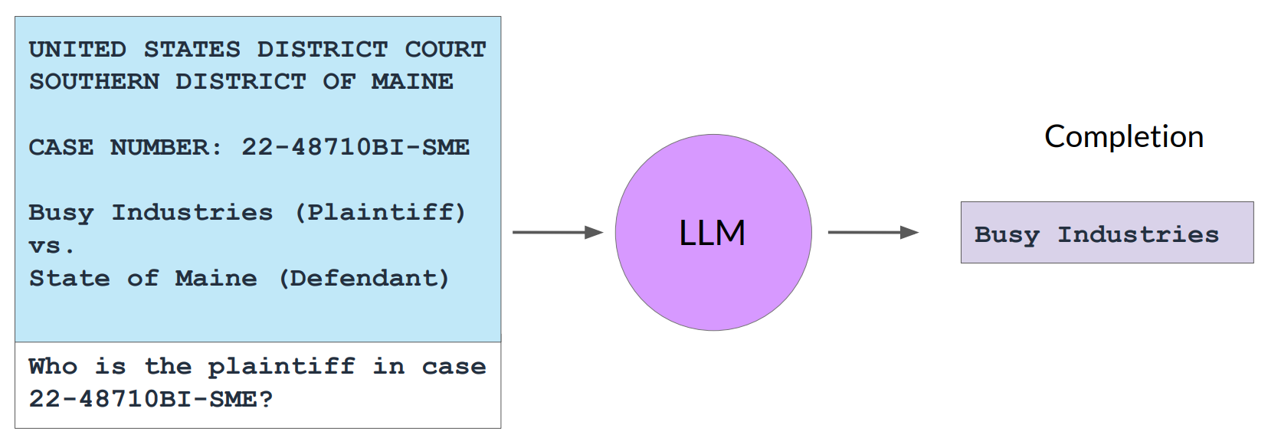
Example: Searching legal documents

Slide 13
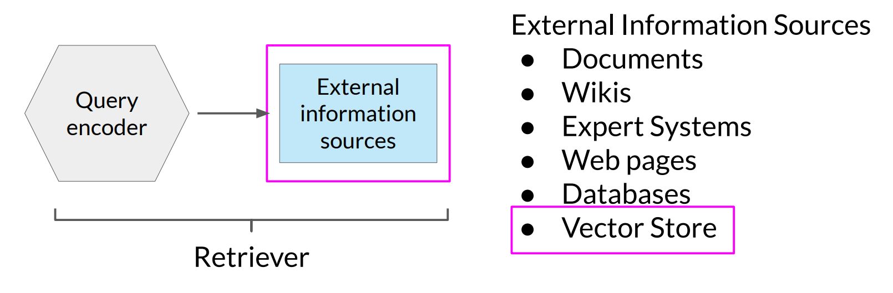
RAG integrates with many types of data sources

Slide 14
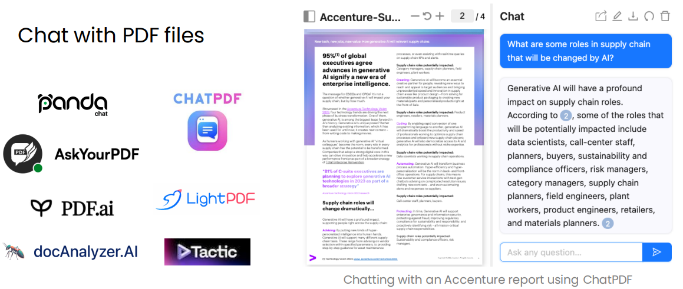
Examples of RAG applications

Slide 15
RAG applications
https://pandachat.ai
https://www.chatpdf.com
https://askyourpdf.com
https://pdf.ai
https://docAnalyzer.ai
https://lightpdf.com

Slide 16
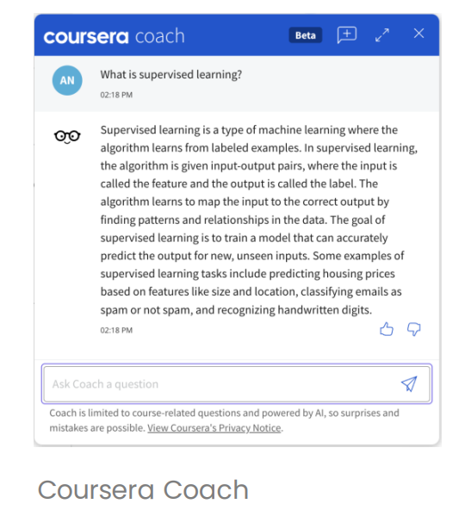
Examples of RAG applications
Answer questions based on a website’s articles
Coursera Coach

Slide 17
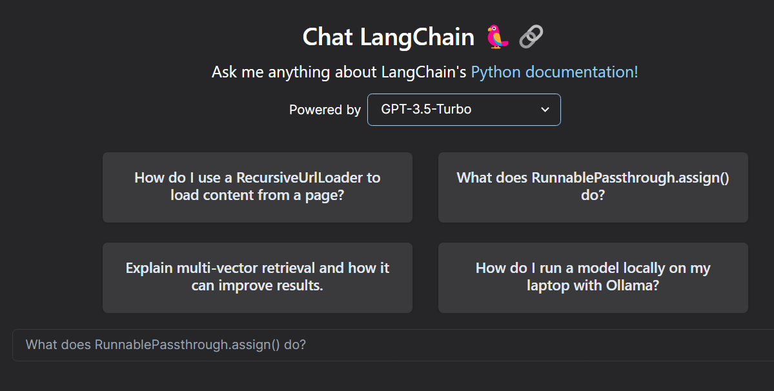
Examples of RAG applications: Langchain Docs

Slide 18
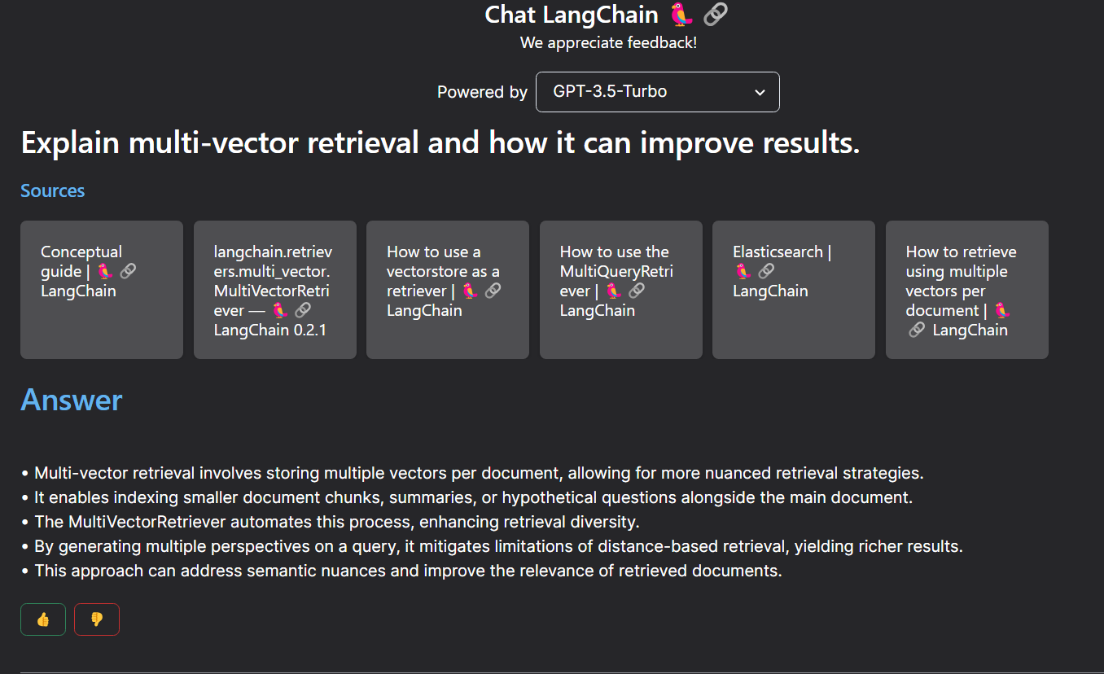
Examples of RAG applications: Langchain Docs

Slide 19
Tools

Slide 20
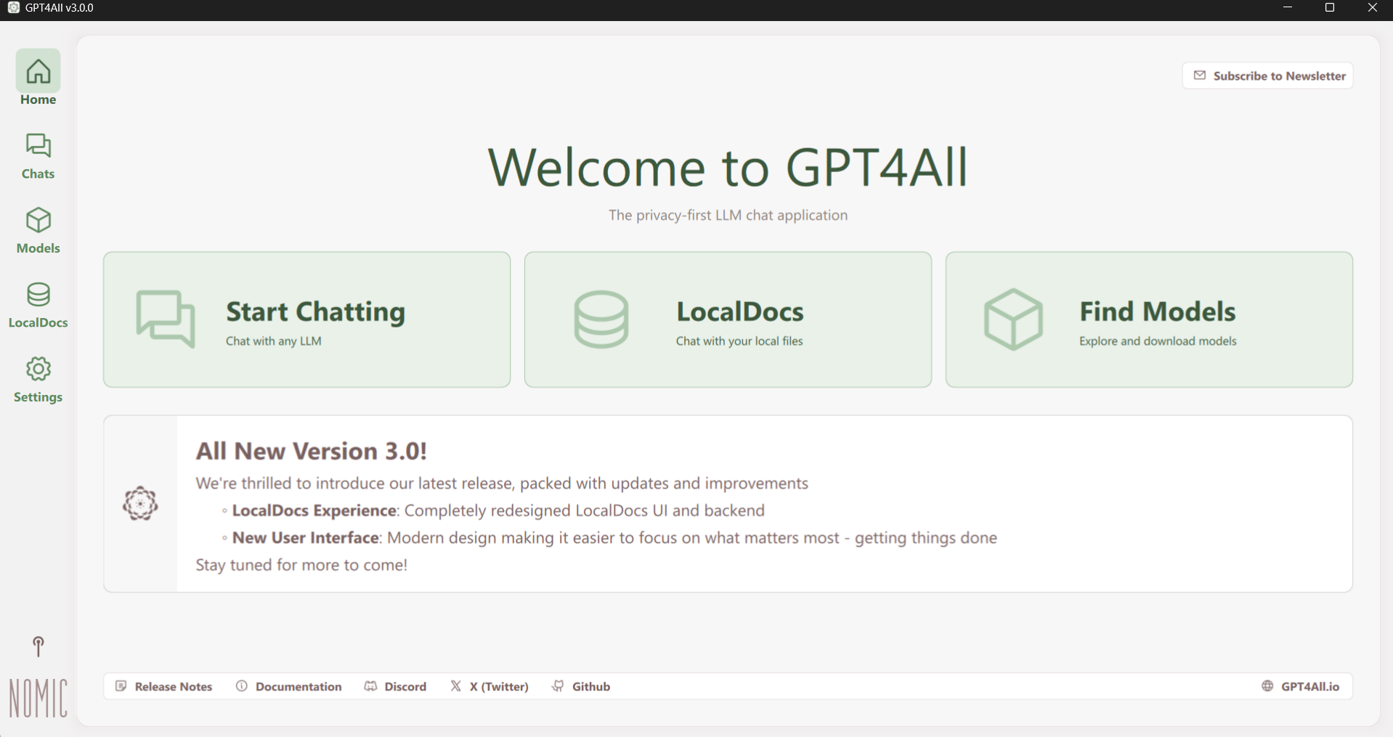
GPT4all RAG

Slide 21
LM Studio

Slide 22
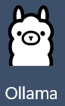
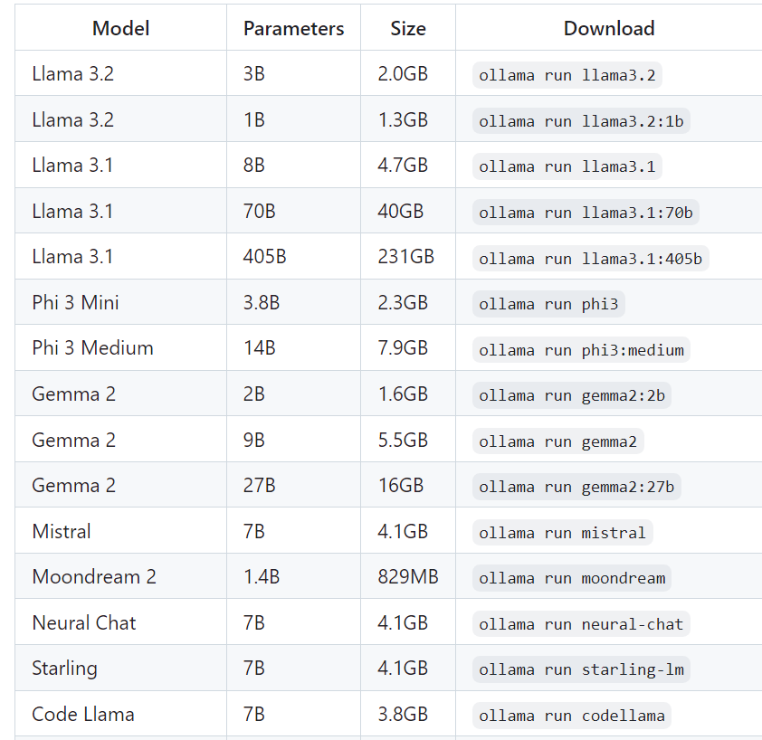
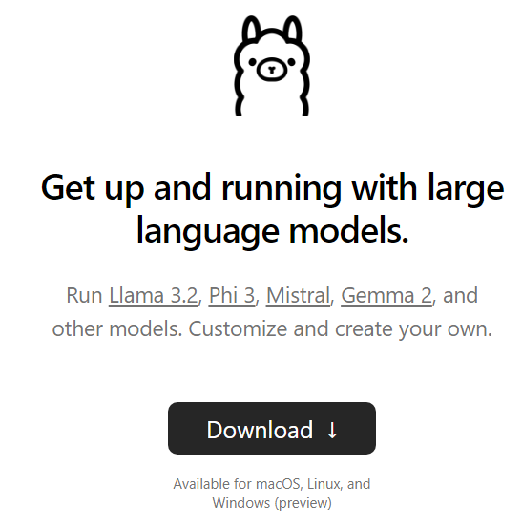
Ollama

Slide 23


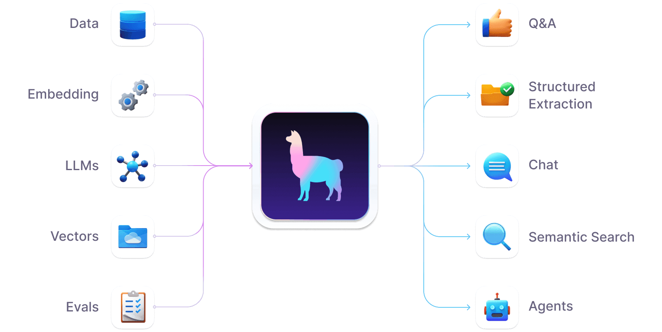
Llama Index

Slide 24


Q&A

